Slide 1


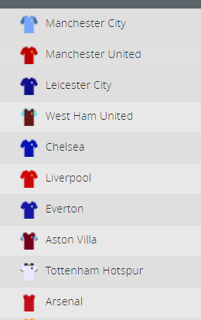
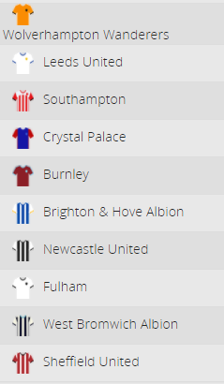
DATA SCIENCE PROJECT
1

Slide 2
STUDENTS
Yaniv Birenboyim – 311276509
Bar Edri - 204536817
2

Slide 3
PROJECT BREAKDOWN
Step 1+2 – Crawling + Scrub
crawling from ‘statbunker’ Premier League stats from 92/93 Season Table to 20/21 Total of 29 Seasons Examination of the data After first examination – fixing ‘Year’ column data Saving the data as csv ‘DataFrameTableTeam’ to avoid repeat crawling process
Step 3 – Explorer
Examination of the full data as csv Adding new ‘Place’ column as indicator for Top 5 and Marking the Top 5 teams : Top 5 = ‘1’ Other = ‘0’ Examining the stats of the Top 5 teams from all seasons Scaling the data – remove of season 20/21 because 20/21 is still running Plotting different subjects in comparison for Place Points Goal scored Goals Matches lost Matches drawn
Step 4 – Models
Examining the data by 3 different models Logistic Regression Linear Regression Decision Tree Regressor Use of models Logistic Regression- Predict the minimum amount of ‘x’ ‘Goal for’ ‘Goals against’ ‘Points’ ‘Matches won’ Required to be in Top 5 Linear and Decision Tree Regressions Predict the Points of ‘x’ amount of season for specific team Predict all teams Places in the table league from all the seasons
Step 5 – interpret
Examining the result of each model Visualizing the result of each model
3

Slide 4

FIRST STEP - CRAWLING
4

Slide 5
HOW DID WE CREATE THE DATA BASE
Used crawling process to get Premier League data
From season 92/93 to season 20/21
Total of 29 seasons
5

Slide 6
Crawling PL data from stat bunker
Crawling using BeatifulSoup
Creating Data Frame which contains the whole data from all seasons
Fixing the ‘Year’ column
Creating new ‘Place’ column as an indicator for Top 5 teams for each season
Top 5 marked as ‘1’ and all the rest are marked as ‘0’
6

Slide 7
OUR DATABASE
Data | Number of teams | Number of Goals | Number of Points | Seasons
PL seasons table | 49 | 28893 | 29807 | 28 (20/21excluded)
7

Slide 8

VISUALIZE THE DATA
8

Slide 9
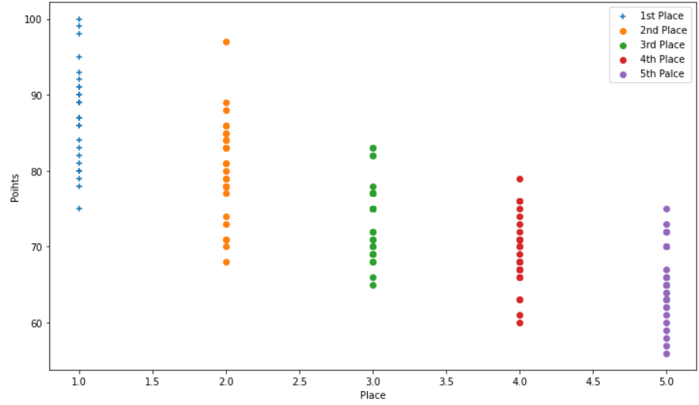
POINTS IN COMPARISSON TO TABLE PLACE
9

Slide 10
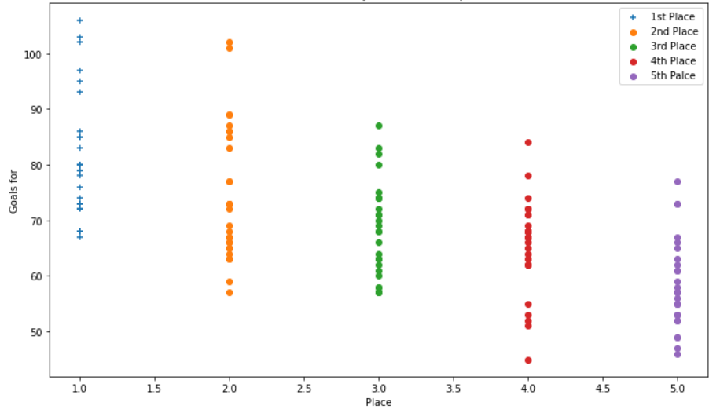
GAOLS FOR IN COMPARISSON TO TABLE PLACE
10

Slide 11
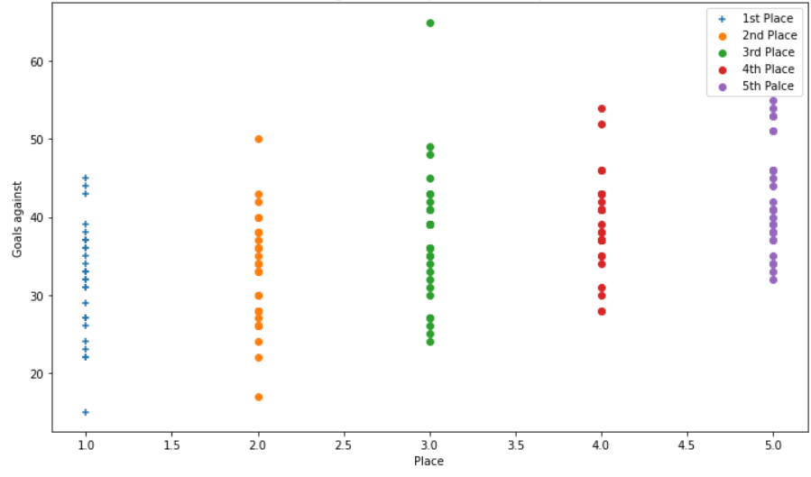
GOALS AGAINST IN COMPARISSON TO TABLE PLACE
11

Slide 12
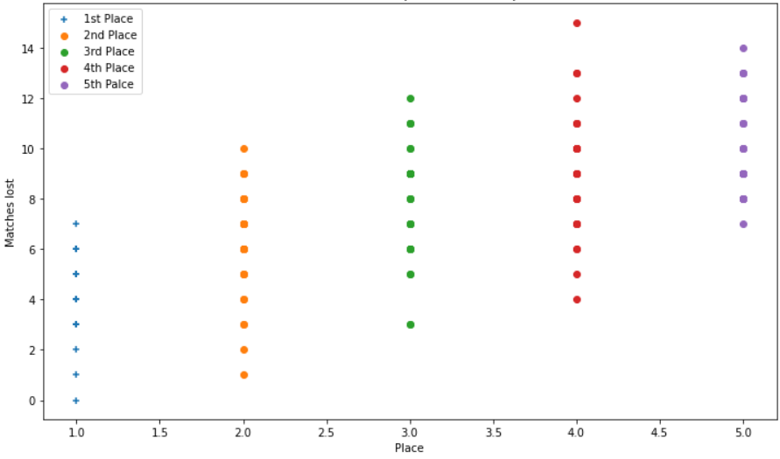
MATCHES LOST IN COMPARISSON TO TABLE PLACE
12

Slide 13
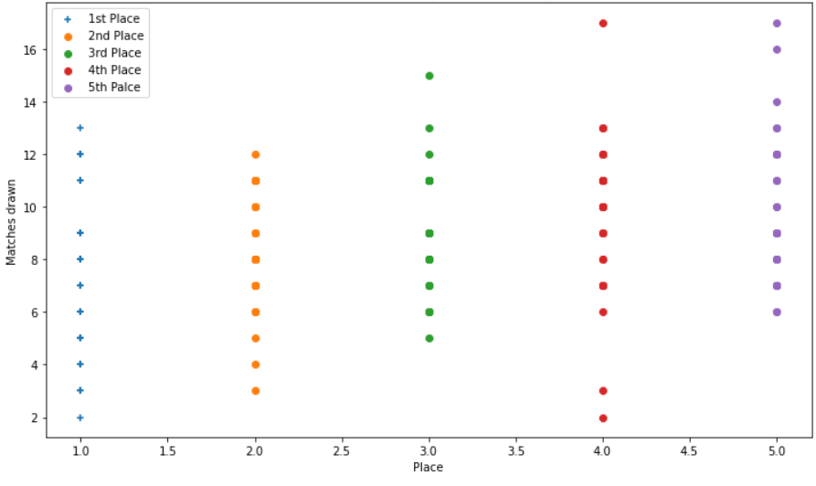
MATCHES DRAWN IN COMPARISSON TO TABLE PLACE
13

Slide 14

SECOND STEP - EVALUATE
14

Slide 15
ANSWERING A FEW QUESTIONS
After crawling the data and getting the information that we need, lets check few common questions:
What are the ‘x’ amount of ‘Goals for’ ,’Goal difference’ ,’Points’ ,’Matches won’ required Inorder to be Top 5 at the end of the season?
Can we predict the ‘Points’ of ‘x’ seasons for specific team?
Can we predict the entire seasons teams place at the end of each season?
15

Slide 16
ADDITIONAL DATA
https://s.click.aliexpress.com/e/_ASNyOq
There are only 6 teams who played in all 28 seasons.
Team | Number of 1st Place | Number of Goals | Number of Wins | Total Points made
Liverpool | 1 | 1859 | 561 | 1948
Tottenham Hotspur | 0 | 1608 | 462 | 1654
Everton | 0 | 1401 | 390 | 1476
Manchester United | 13 | 2055 | 666 | 2234
Arsenal | 3 | 1901 | 579 | 2011
Chelsea | 5 | 1839 | 578 | 1997
Total | 22 | 10663 | 3236 | 11320
16

Slide 17

MODELS USED
Logistic Regression
Decision Tree Regression
Linear Regression
17

Slide 18
PREDICT ‘X’ AMOUNT OF: GOALS FOR, GOAL DIFFERENCE,POINTS,MATCHES WON REQUIRED TO BE IN TOP 5
Scaled down the data to the top 5 teams from each season only
Used Logistic Regression to determine the minimum requirement
Minimum Goals | Minimum Goal Difference | Minimum Points | Minimum Wins
62 | 18 | 64 | 18
18

Slide 19
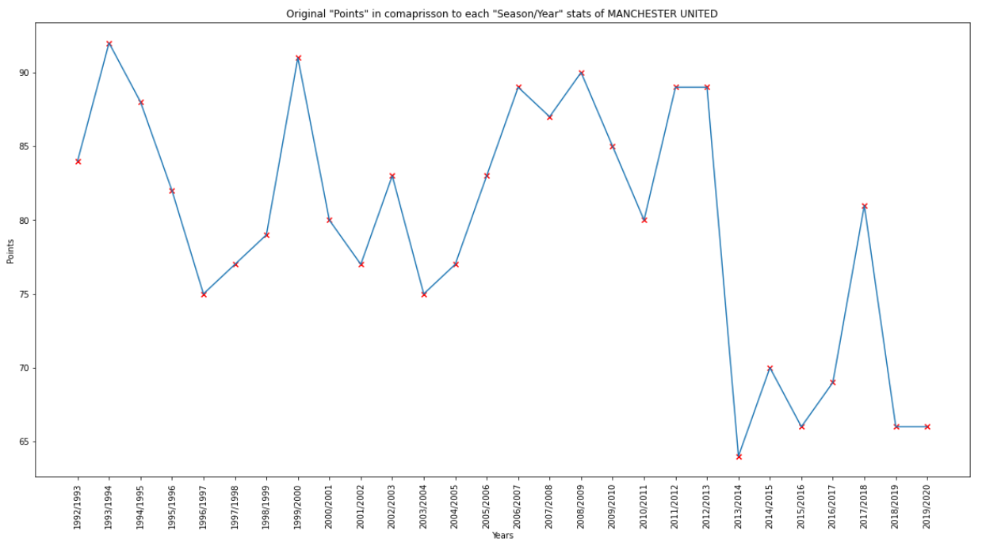
Can we predict the ‘Points’ of ‘x’ seasons for specific team?
Scaled down the data to specific team – Manchester United
Chose the team Manchester United because of most Premier League 1st Places (13 times)
Used both Linear and Decision Tree Regressions in order to see the difference between the models
19

Slide 20
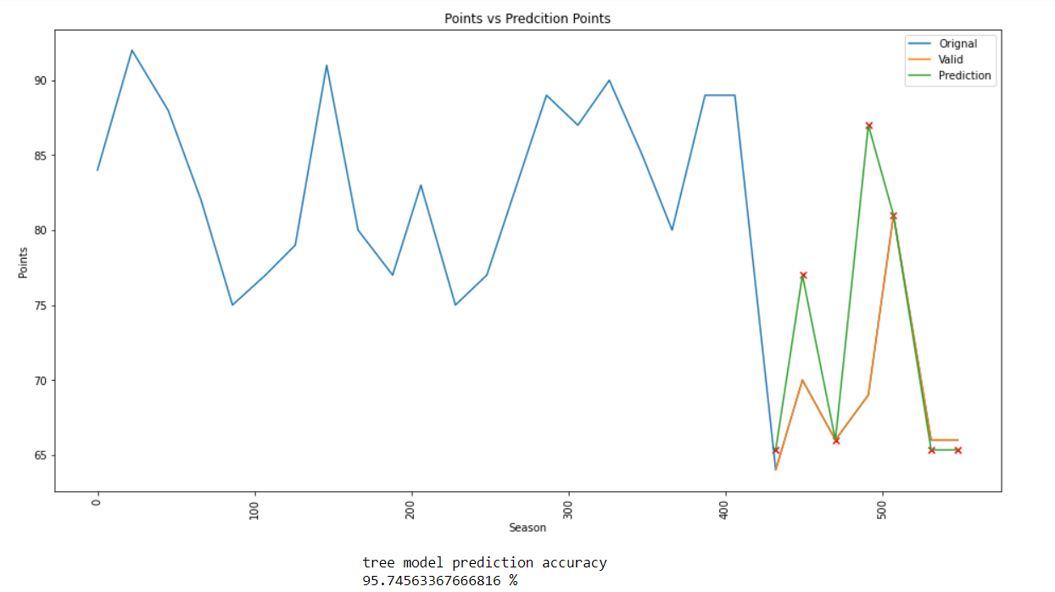
DECISION TREE REGRESSION
Visualize the results
20

Slide 21
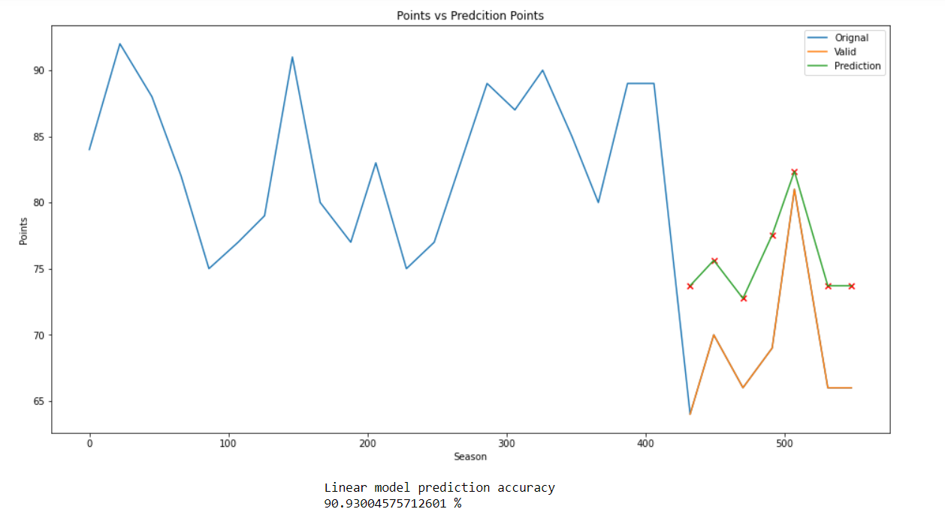
LINEAR REGRESSION
Visualize the results
21

Slide 22
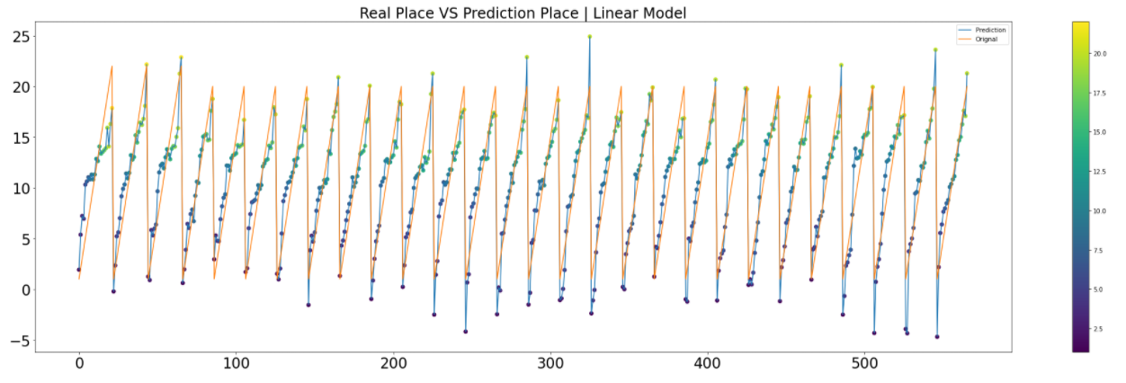
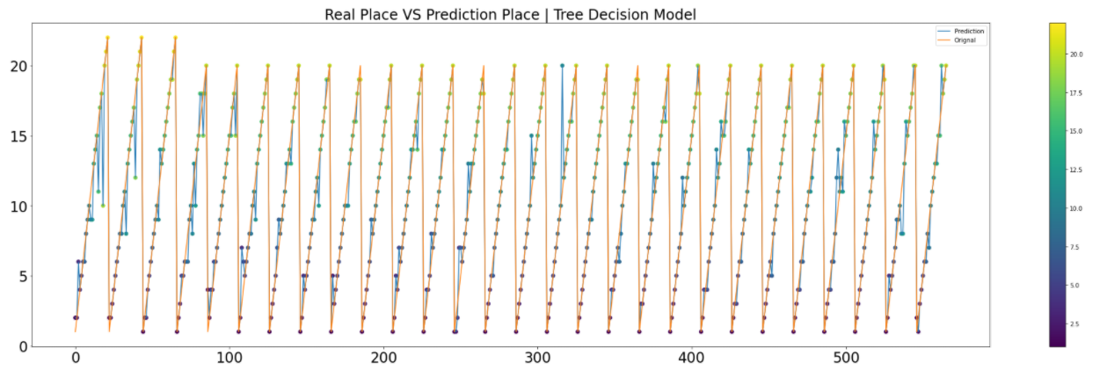
LINEAR VS TREE DECISION REGRESSION
Real Place Vs Perdition Place for all seasons
Linear Model
Tree Decision
Model
VS
22

Slide 23
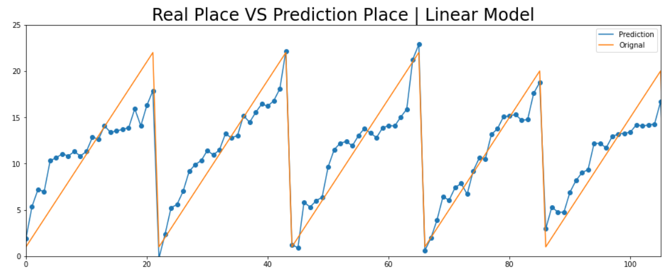
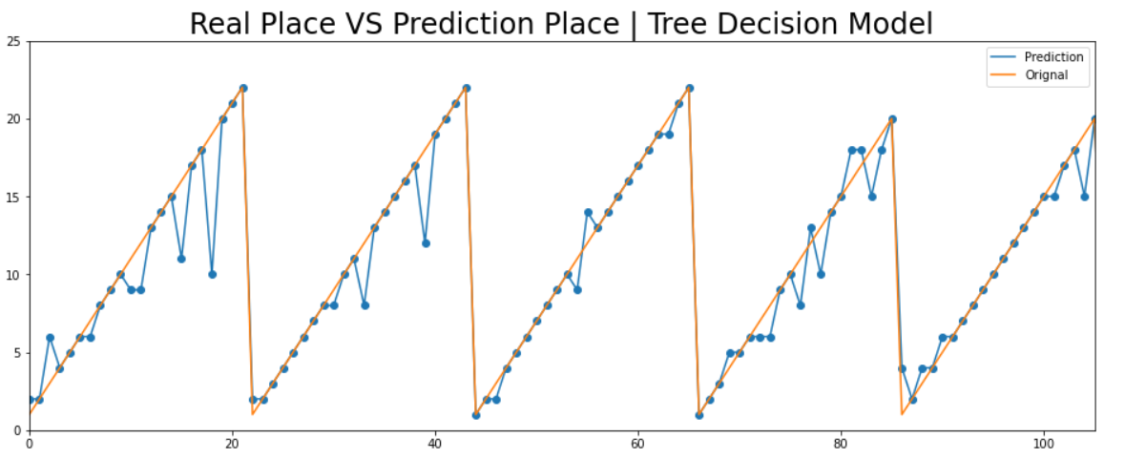
LINEAR VS TREE DECISION REGRESSION
Visualize the result on smaller scale
5 seasons instead of all 28 seasons
Real Place Vs Perdition Place for all seasons
Linear Model
Tree Decision
Model
VS
23

